Slide 1

TikTok Android Mobile App Clone - using Flutter & Dart
Group Members:
Heng Sombo
Som Sothea

Slide 2
Introduction to Flutter and Dart
Flutter
Dart
A cross-platform UI toolkit designed by Google for building native-like apps for web, mobile, and desktop.
A modern object-oriented programming language developed by Google, optimized for client-side development.

Slide 3
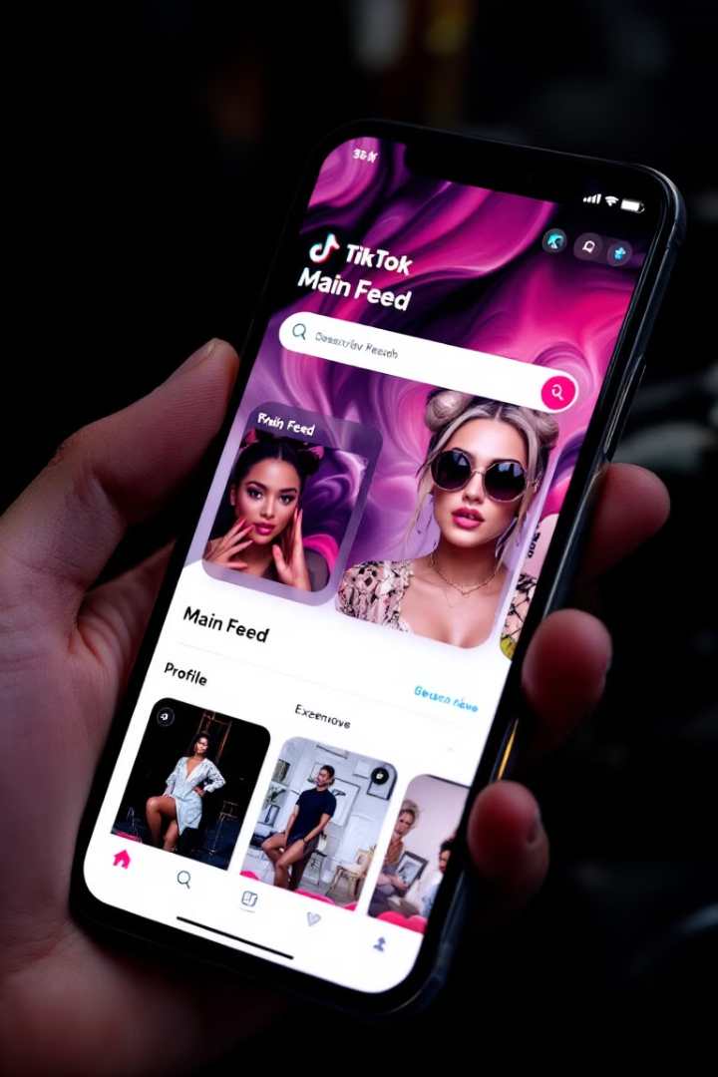
Key Features of TikTok App
Home Feed
Video Creation
Personalized feed of short-form videos.
Upload or post video
Social Features
Profile
Inbox or Chat Screen.
Register and Login Screen

Slide 4
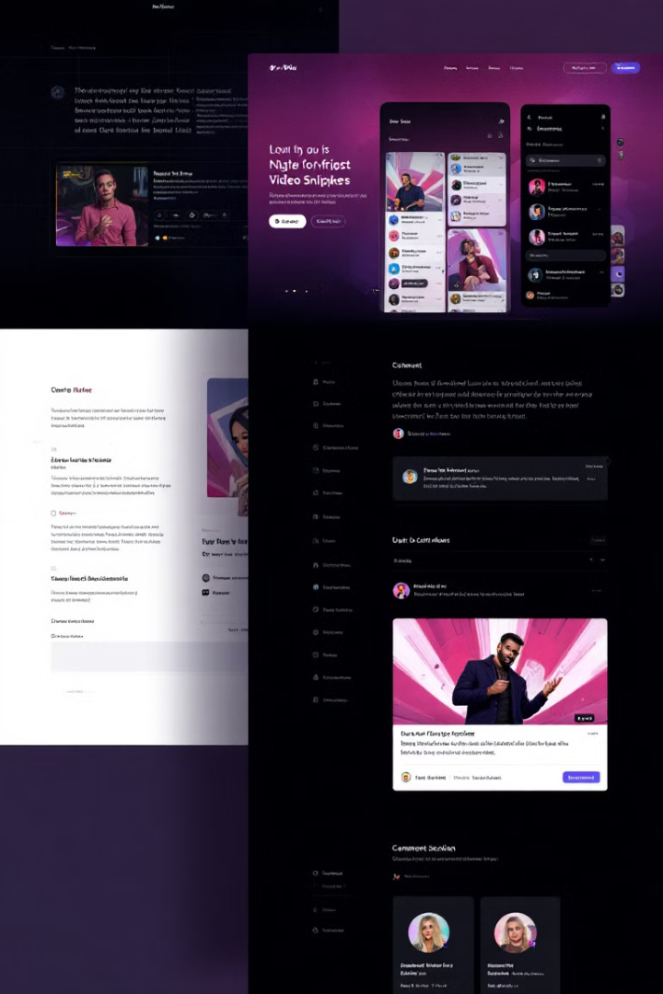






Home Screen
Video Player
User Profiles
Comment Section
Like Button
Share Button
Sound Section

Slide 5

Dependencies Packages
video_player
cupertino_icons
A Flutter plugin for iOS, Android and Web for playing back
video on a Widget surface.
Default icons asset for Cupertino widgets based on Apple styled icons.
provider
http
A wrapper around InheritedWidget to make them easier to use and more reusable.
A composable, multi-platform, Future-based API for HTTP
requests.

Slide 6

Thanks for your attention.

